Slide 1



Reasoning Revolution Cracking the Code of LLM Intelligence
Asim Munawar
IBM TJ Watson Research Center, New York
ACMSE 2025 – April 24-26, 2025

Slide 2
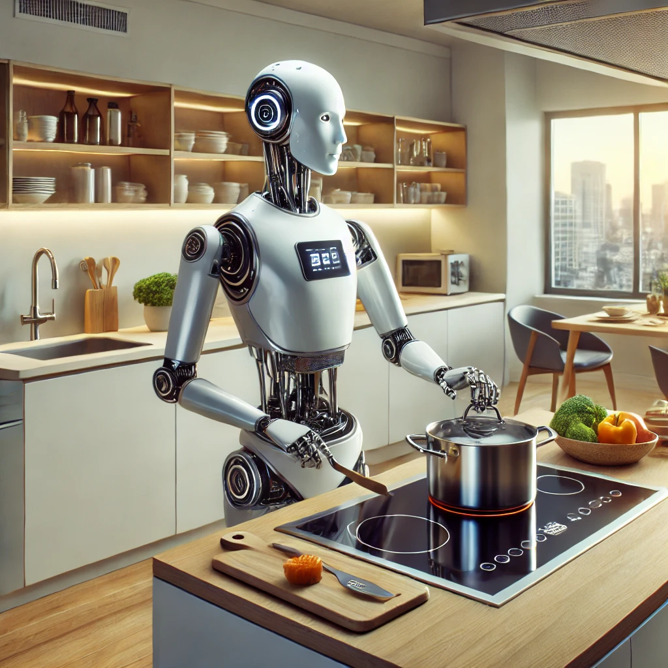


vs.
What we have !!!
What was promised !!!
Images generated by DALL·E

Slide 3



No final verdicts — this is an evolving story
I won’t show LLM failures… okay, maybe just a few 😉
Confused at the end? Perfect.
That means you really got it.
Reasoning with LLMs
Why Reasoning Matters?
Benchmarks & Challenges
Large Reasoning Models
What’s Next?

Slide 4
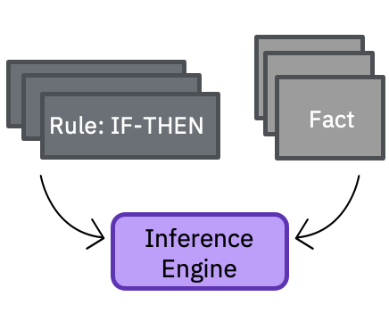
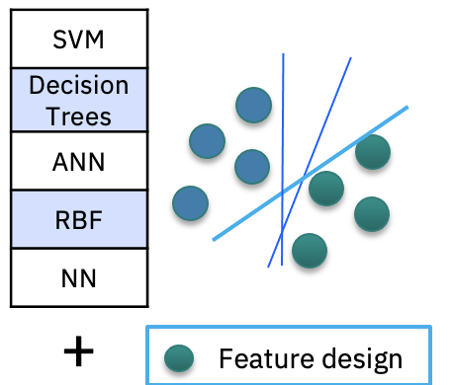
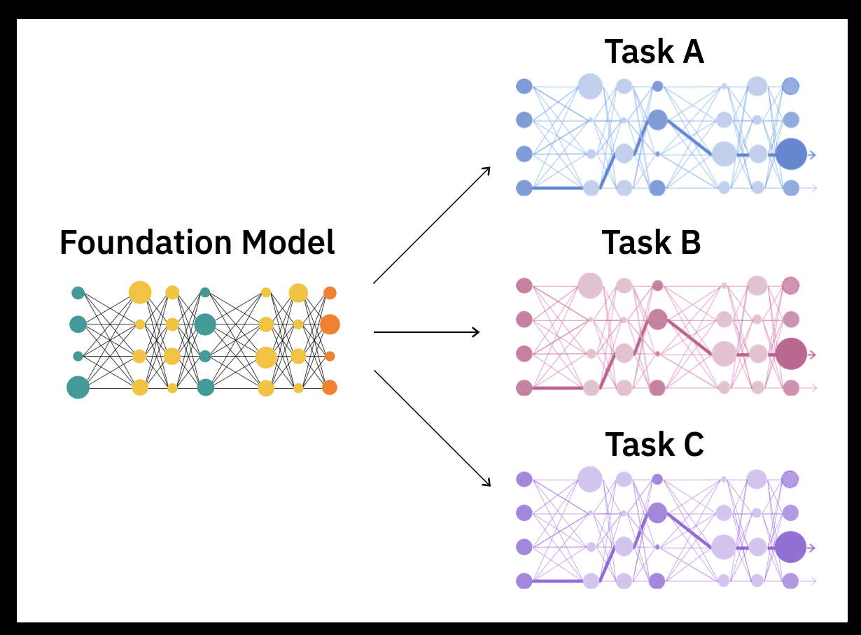
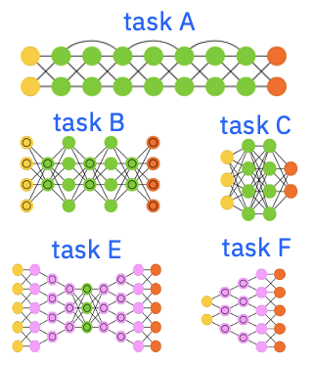
1980s
Big data
1980s to ~2010s
Massive labeled data + Compute
2010+
Self-supervision at scale
+
Massive unlabeled data + Compute
2017+
Expert systems
Rule engines
Machine learning
ML algorithms
Task-specific decision boundaries
Dimension reduction
Feature engineering
Deep learning
Network architectures
Task-specific decision boundaries + feature representations
Large Language Models
Base model
Adaptable decision boundaries and feature representations
Notes:
Generative AI represents the latest innovation in the long history of the artificial intelligence (AI) journey on data representations. It began with expert systems and early inference engines in the 1980s using symbolic representations of data.
The modern era of AI and machine learning (ML) began in the 1980s and culminated in deep learning in the later part of the 2010s. These models required a massive amount of labeled data to train. The resulting models were targeted for specific tasks and while these models could be successful, they were expensive (finding and labelling sufficient data) and not easily transferrable to other tasks not initially thought about when model training began. Solving different tasks (even though they may be related) required another set of labeled data and retraining. Such task-specific learning models were not scalable and became expensive. This is analogous to training an intern to understand and interpret legal documents versus medical content. These industries have different vocabularies, ways of thinking, and ways to resolve gray areas, among other differences.
New ideas, innovation, and new techniques began to emerge in the late 2010s to provide the next leap in AI modelling – foundation models and generative AI. Unlike the traditional ML and AI models, foundation models are trained on massive but unlabeled data sets and use self-supervised learning. Foundation models have a much broader base (foundation). Today, Large Language Models (LLMs, a type of foundation model) have proven to be very useful, especially in initial applications for areas in natural language processing (NLP) tasks.

Slide 5
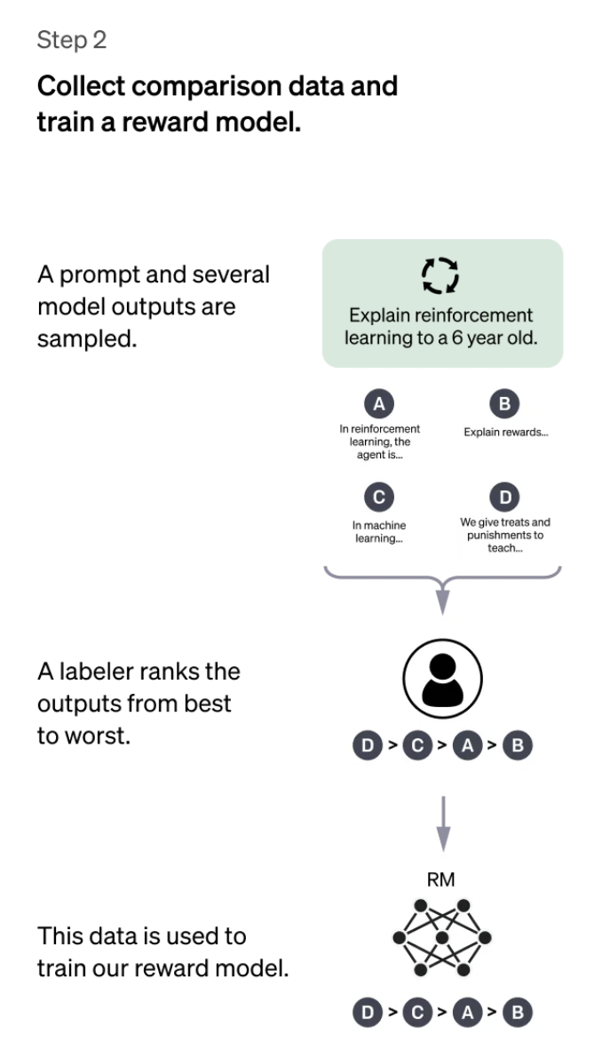
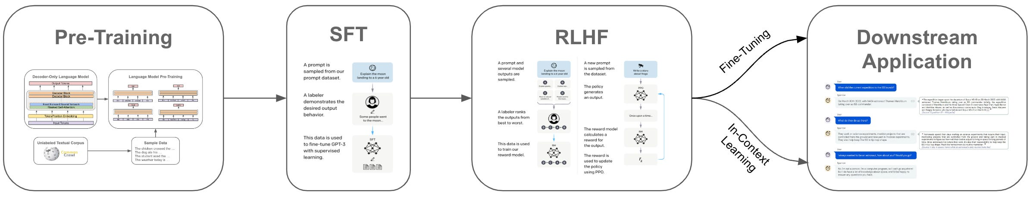
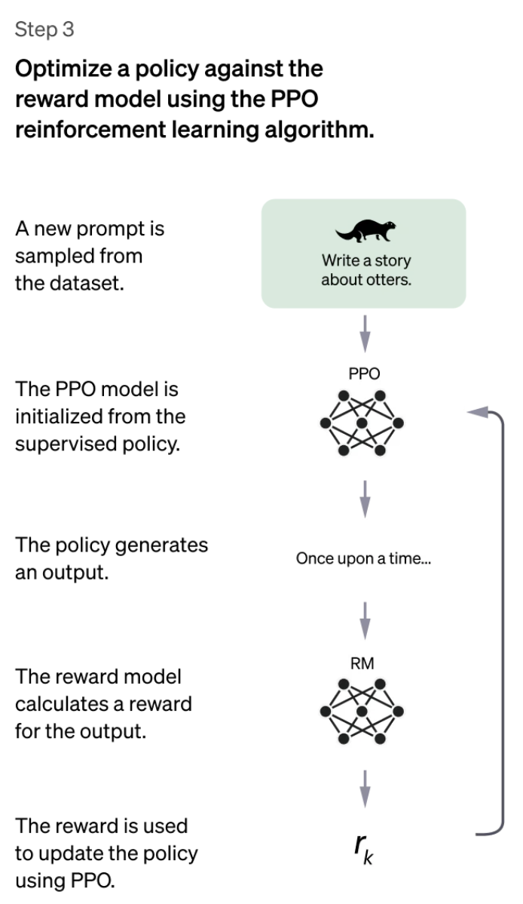
LLM Training
Reward Model
Preference Pairs
Instruction – Good response – Bad response
Internet scale unstructured data
Instruction Response
pairs
Diverse Instructions

Slide 6
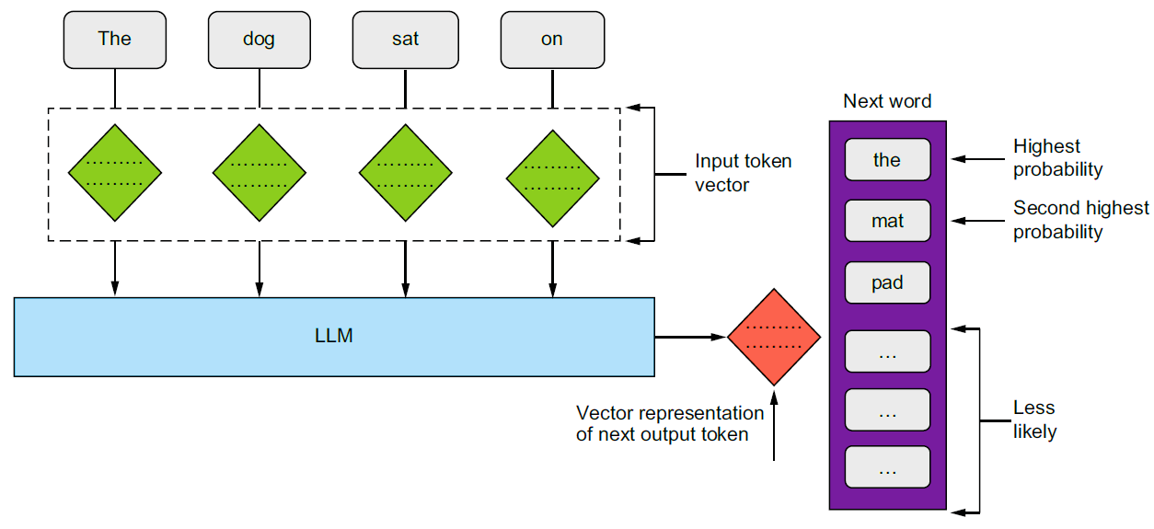
LLMs are Next Token Predictors
sdf

Slide 7
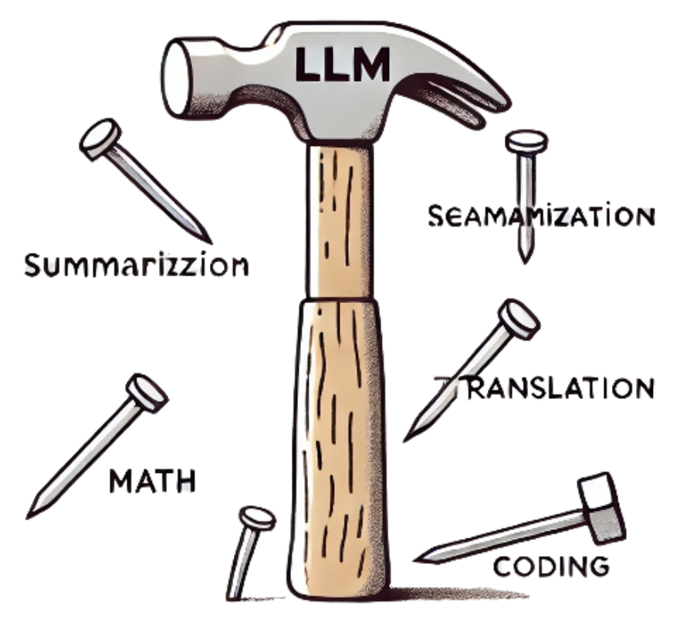
"When the only tool you have is a hammer, every problem looks like a nail.”
LLMs are today’s hammer — so easy to use, every problem starts to look like next-token prediction.
But true intelligence demands more than just completing the next word.

Slide 8
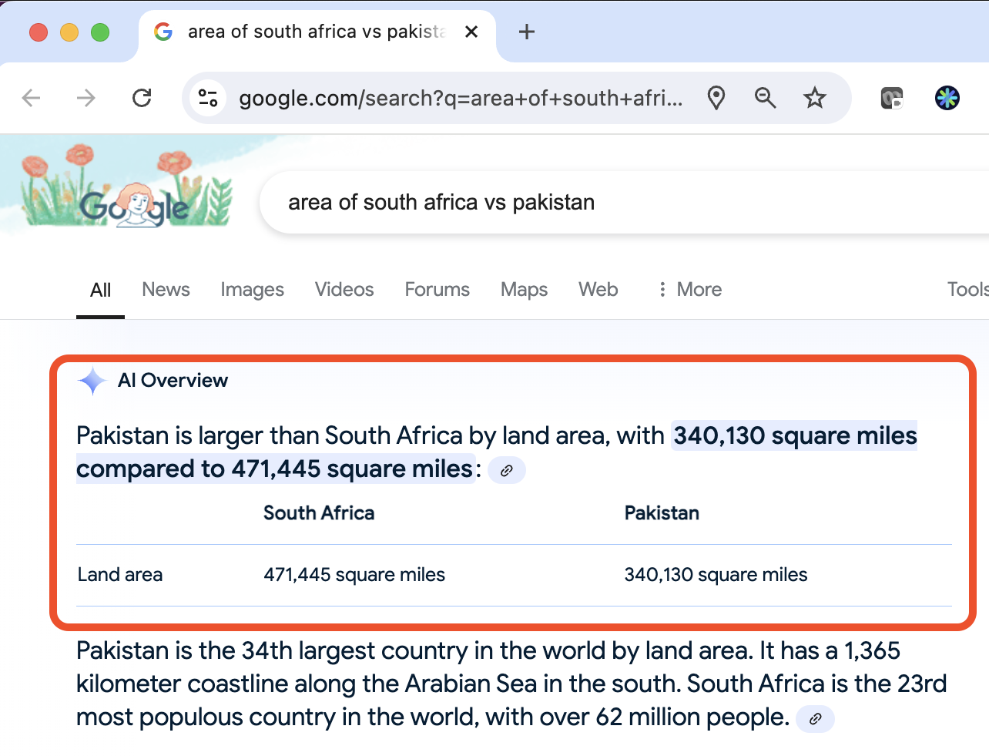
Reasoning with Large Language Models

Slide 9
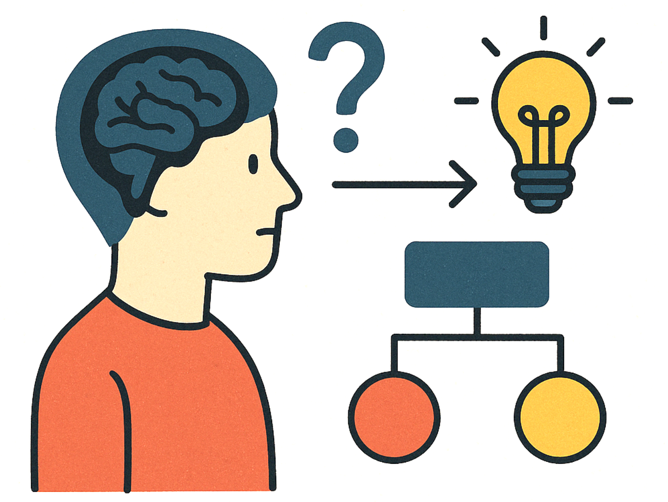
What is Reasoning?
Process of thinking about something in a logical and systematic way, using evidence and past experiences to reach a conclusion or make a decision.
Formal Reasoning
Symbolic logic, math
Precise, rule-based
Challenges: complexity, real-world ambiguity
Natural Language Reasoning (aka. Informal Reasoning)
Human-like understanding
Contextual, nuanced
Challenges: ambiguity, subjectivity
So, isn’t everything reasoning then?

Slide 10
Reasoning
The ability to think step by step and infer new conclusions from existing clues.
Enables us to make sense of incomplete information and answer questions beyond what’s explicitly given.
Tells the story behind the scene
vs.
Knowledge
Drawn from past experiences and stored information.
Labels the scene
Example: You walk into the kitchen and see a boiling kettle, but no one around.
You infer
Someone was just here.
Tea or coffee is being prepared.
It’s probably break time.
You recognize
That it’s a kettle.
That steam means it’s boiling.
That people usually boil water for tea or coffee.

Slide 11
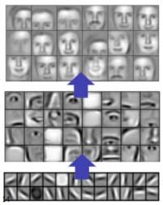
Reasoning also helps with Explainability
Global Explainability
Analyze the structure of the model to understand its capabilities.
Which input features contribute most to the model's output.
Local Explainability
Explaining the prediction for a single data point.
Counterfactual Explanations - What would need to change in the input to alter the model's prediction.
Notes:
Local: Why the model made a particular decision.

Slide 12
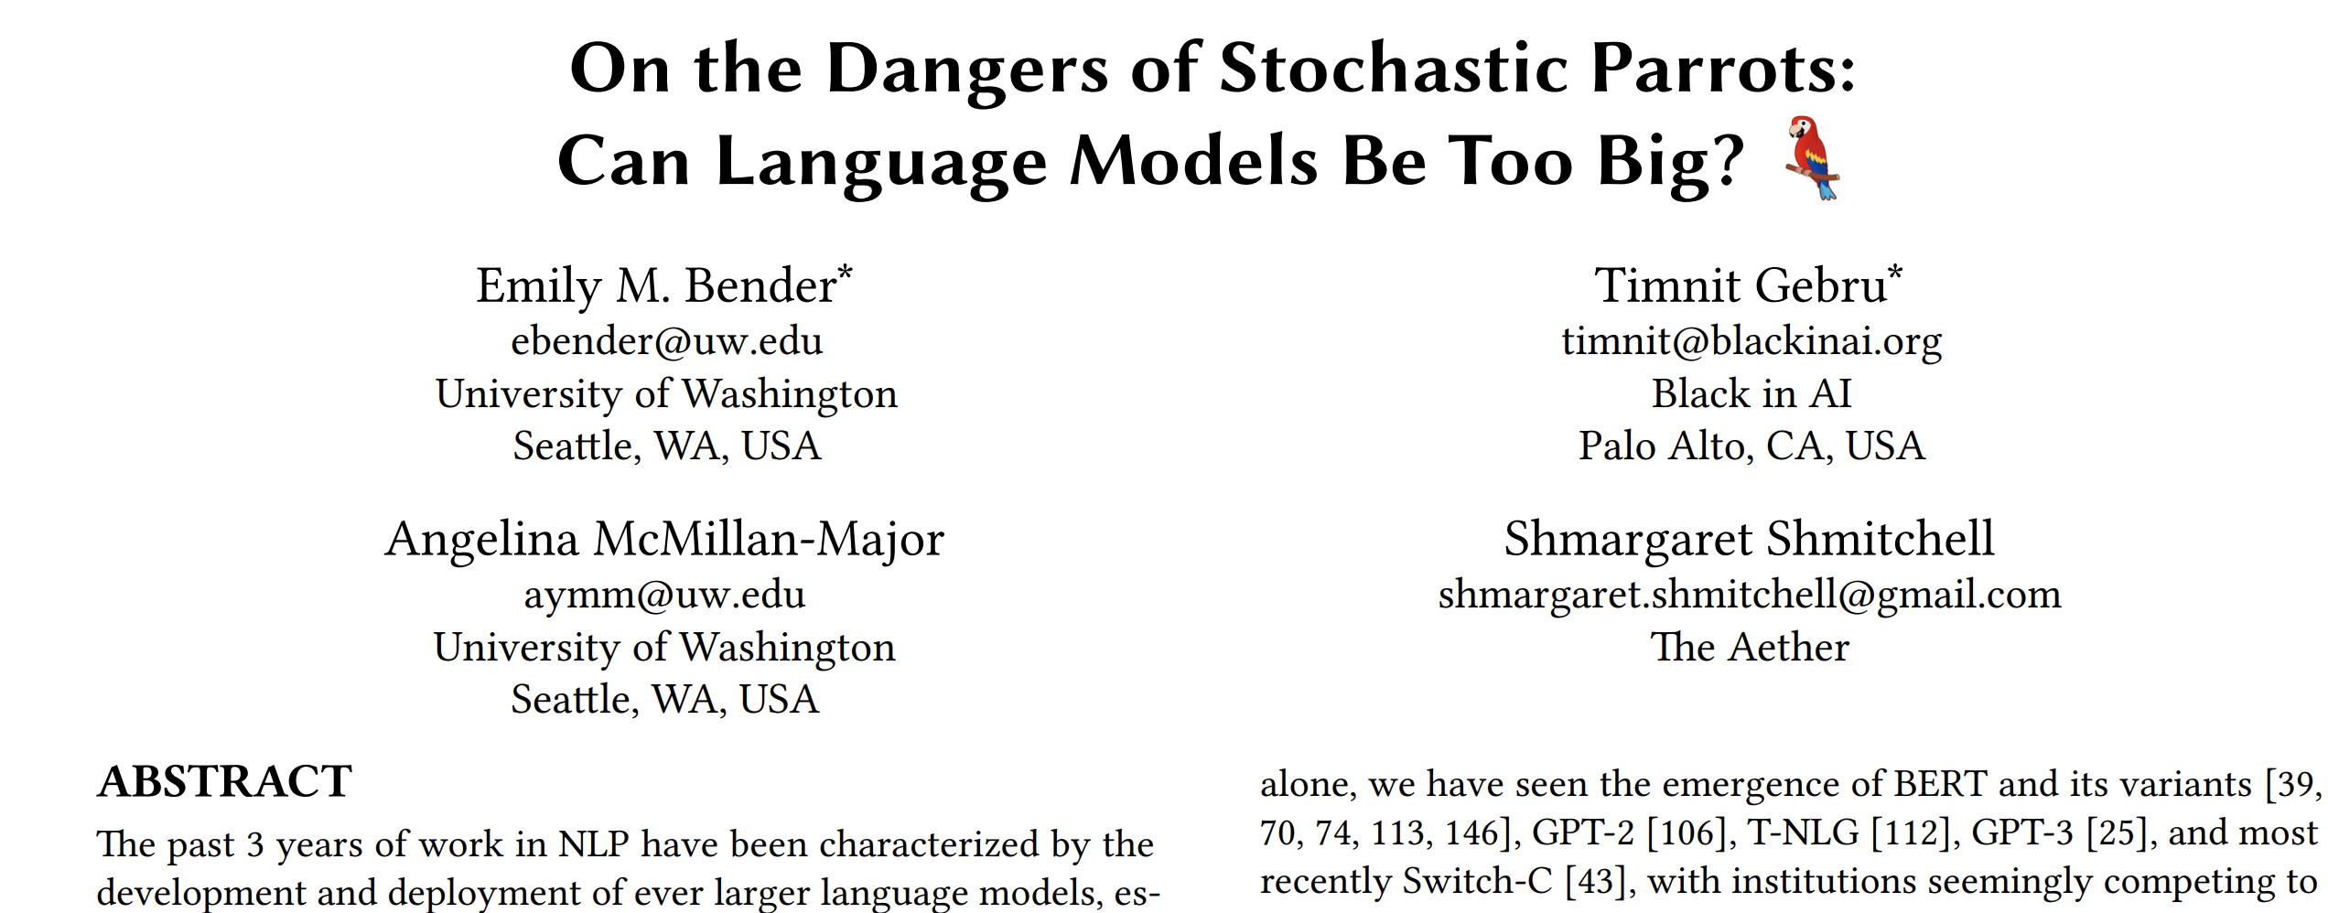
Do LLMs think/reason like humans?
Language Models
Predict the next token statistically
No understanding, intent, or awareness
No memory of past experiences (unless explicitly given)
Output is shaped by training data, not lived experience
Humans
Reason through problems with logic and emotion
Draw on memory, world knowledge, and imagination
Speak with goals, motives, and sometimes hidden agendas
Often know what they want to say before speaking

Slide 13
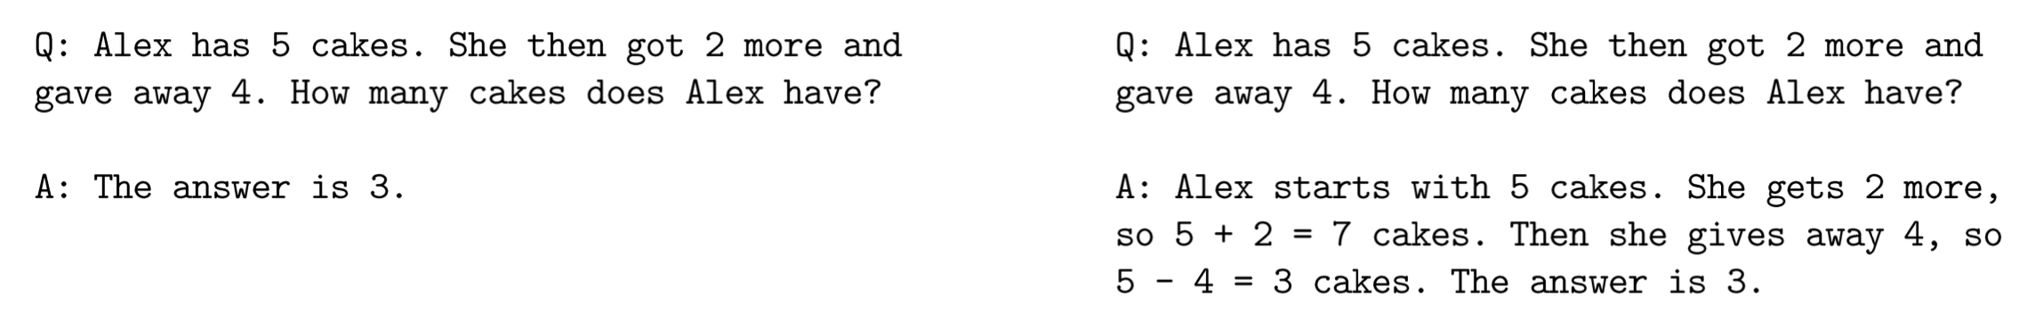
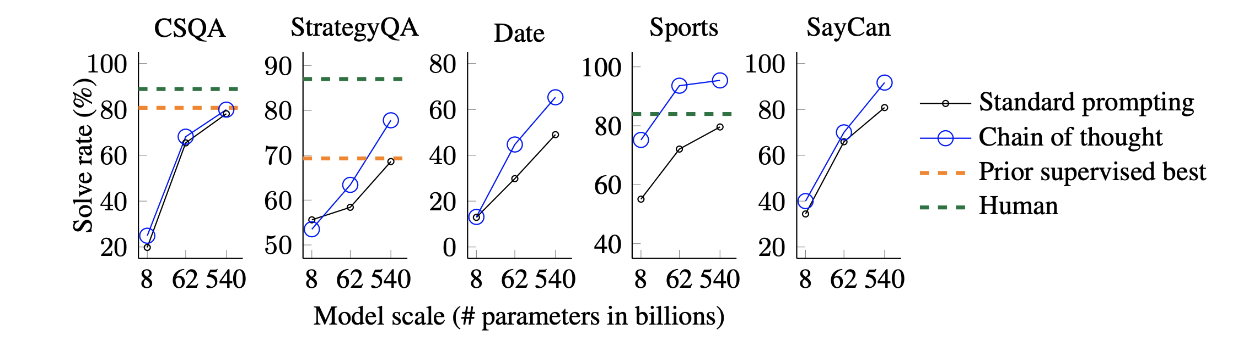
Chain of Thought - CoT
Step-by-Step Reasoning
Improves Accuracy
Explainability
Debugging
Standard prompting
Chain-of-thought prompting
[Wei et al 2022]

Slide 14
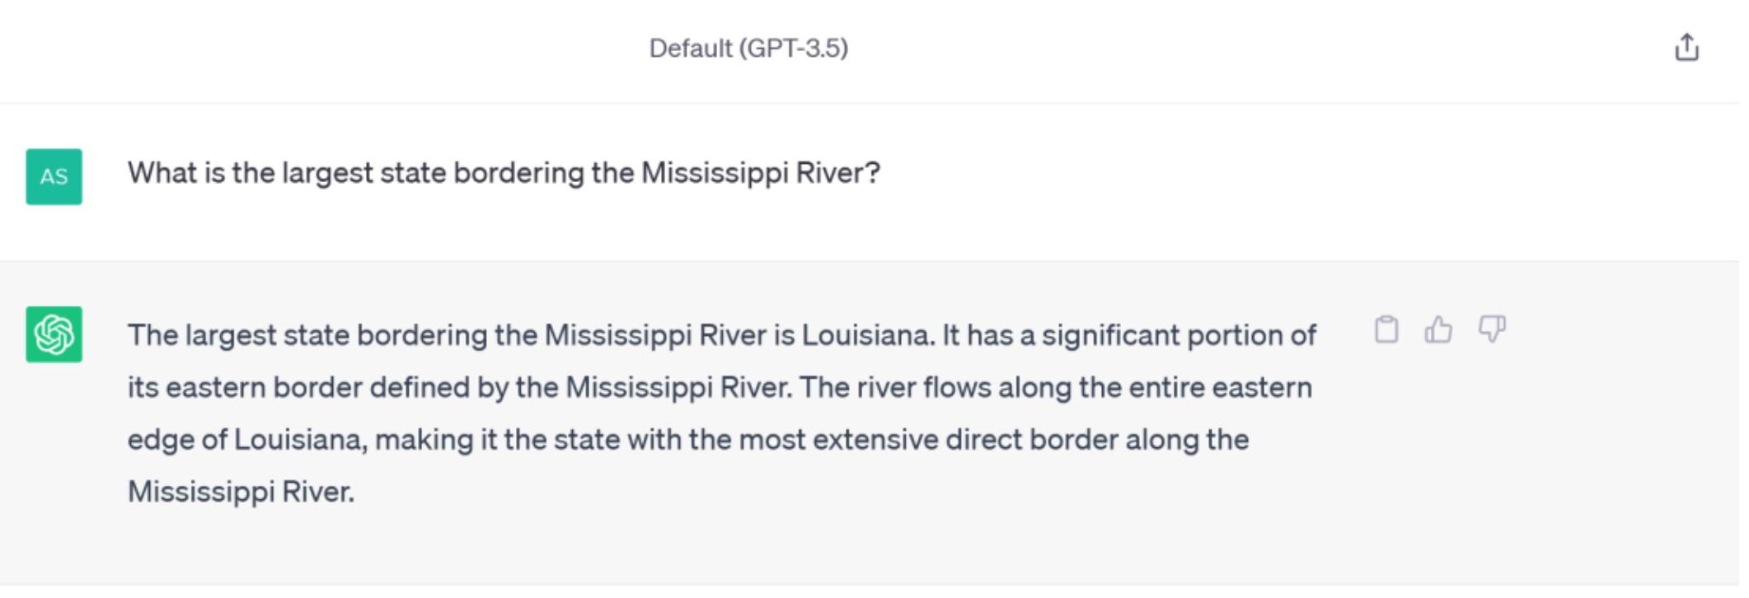
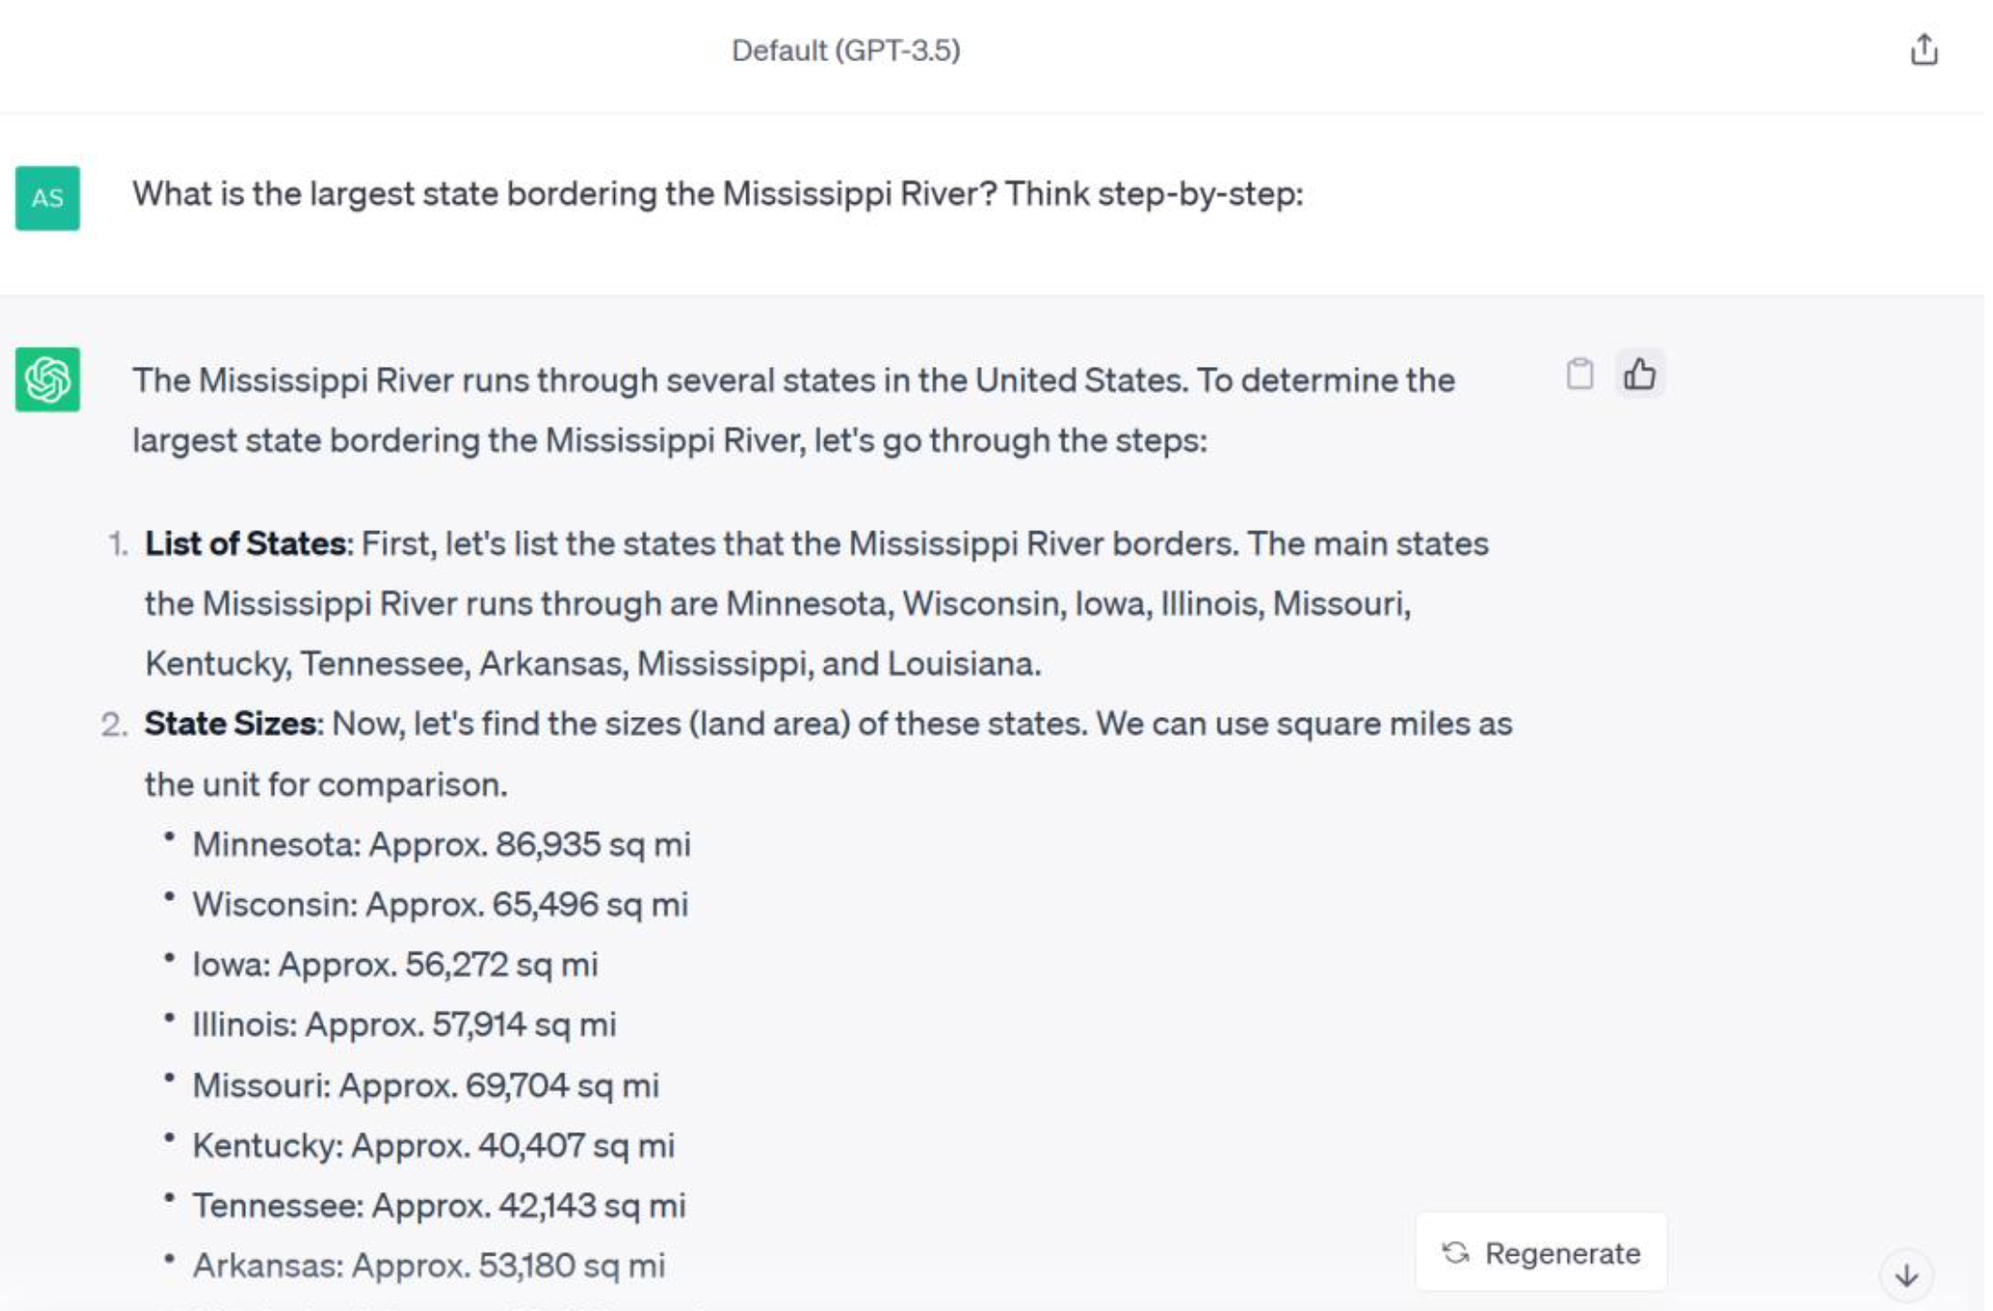
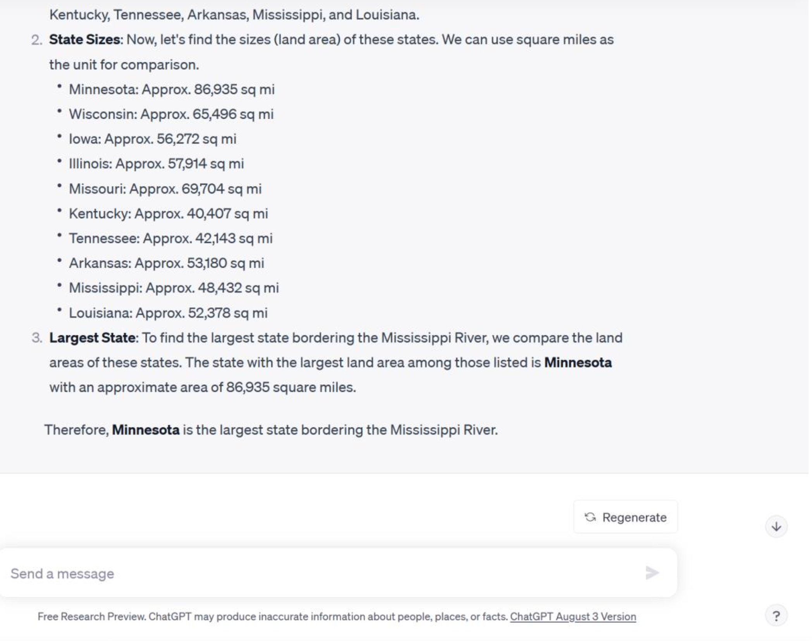

Zero-shot CoT
[Kojima et al 2022]

Slide 15
Advanced CoTs (without verifiers)
Input
Input
Input
Output
Output
Output
Simple Prompting
CoT
CoT with Self Consistency

Slide 16
Advanced CoTs (with verifiers)
Input
Input
Input
Output
Tree of Thought
Best of N
Monte-Carlo Roll-outs to check each step of CoT

Slide 17

So, LLMs can reason
Not so Fast ☹

Slide 18
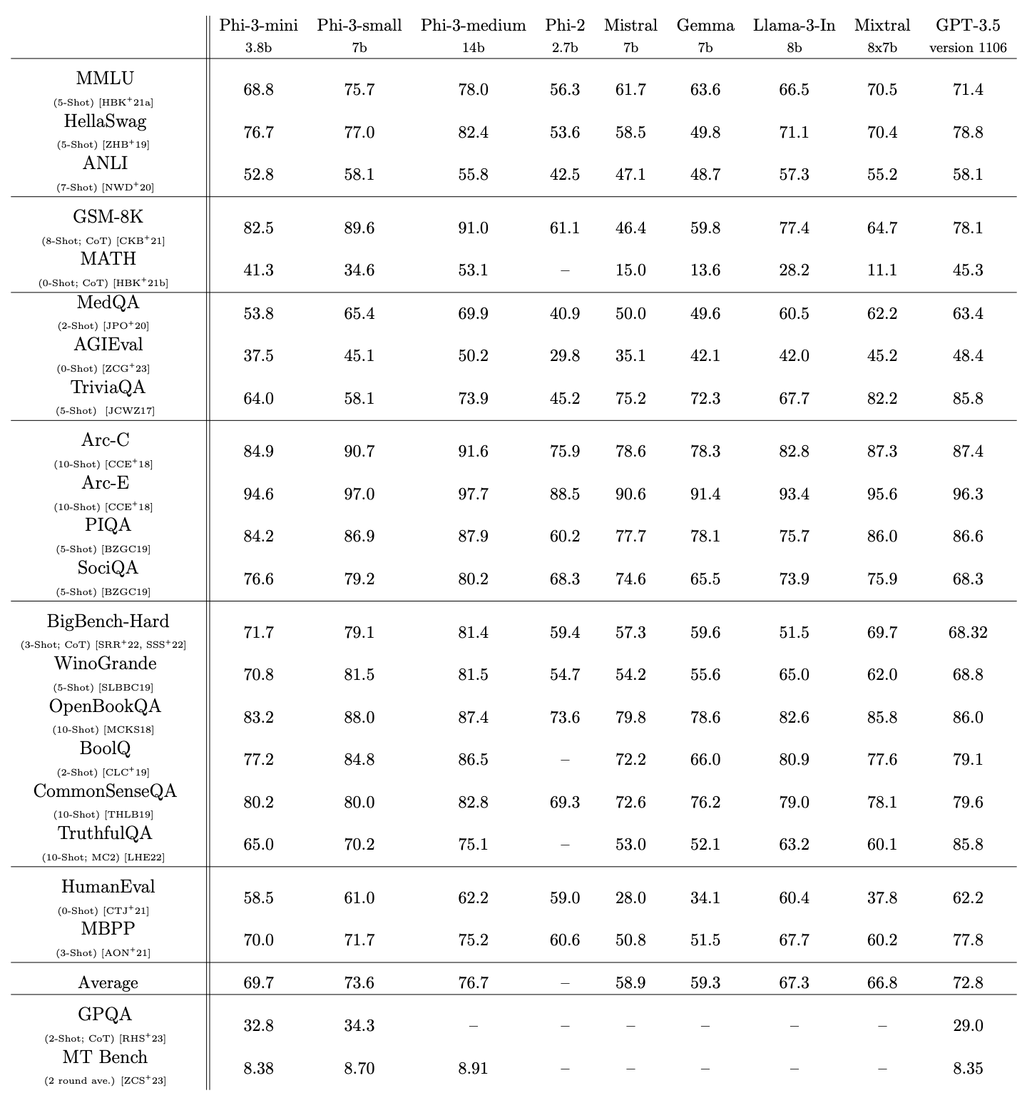
How do we even Evaluate?
LLMs do perform well on many benchmarks, sometimes better than a subject matter expert (SME)
Dataset | Full Name | Description
gsm8k_cot | Grade School Math 8K (Chain of Thought) | Grade-school math problems requiring step-by-step reasoning for solutions.
bbh_cot_fewshot | Big Bench Hard (Few-shot Chain of Thought) | Challenging reasoning tasks with few-shot chain-of-thought prompts.
ai2_arc | AI2 Reasoning Challenge | A question-answering benchmark testing scientific and commonsense reasoning.
mmlu | Massive Multitask Language Understanding | Multi-task benchmark for language understanding across diverse knowledge domains.
commonsense_qa | Commonsense Question Answering | Multiple-choice questions assessing everyday commonsense knowledge.
hellaswag | HellaSwag Commonsense Completion | A commonsense reasoning task for choosing the most plausible sentence continuation.
openbookqa | OpenBook Question Answering | Open-book multiple-choice questions assessing science and general knowledge reasoning.
piqa | Physical Interaction Question Answering | Physical reasoning task focusing on everyday physical interactions and intuitive physics.
race | Reading Comprehension Dataset | Reading comprehension dataset with questions based on middle and high school exams.
social_iqa | Social Interaction Question Answering | Social commonsense reasoning tasks requiring understanding of interpersonal scenarios.
Abdin, M., et al. (2024). Phi-3 Technical Report: A Highly Capable Language Model Locally on Your Phone. arXiv. https://arxiv.org/abs/2404.14219

Slide 19
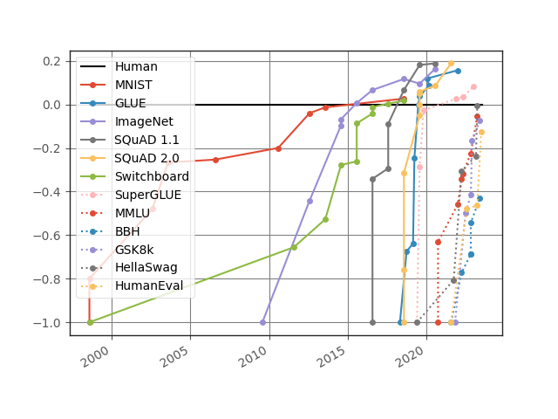
Potential Confounders
“LLMs can appear to reason but their core function is more like sophisticated pattern matching and information retrieval rather than true, human-like reasoning”
Subbarao Kambhampati - ASU
Some benchmarks focus on limited domains (e.g. Math, Code)
Usually verify only the answer, not reasoning.
Templated benchmarks can be deceiving
Contamination: reasoning ability or retrieval ability
May exploit artifacts and shortcuts
https://contextual.ai/news/plotting-progress-in-ai/

Slide 20
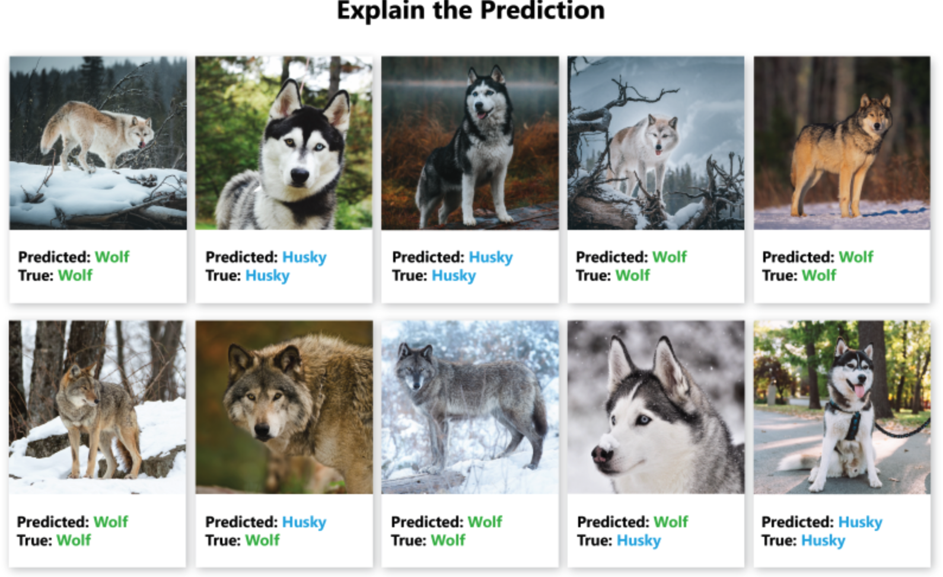

Can AI hack a Dataset?
Attention?
https://carpentries-incubator.github.io/data-science-ai-senior-researchers/05-Problems-with-AI/index.html

Slide 21
Types of Reasoning
Induction – Learning from Examples
LLMs generalize from large-scale pretraining data, capturing statistical patterns across language.
LLM Mechanism: Pretraining Example:
Observation: The sun rises every day
Generalization: The sun always rises
Deduction – Applying Rules to Cases
LLMs can simulate rule-based reasoning when given structured prompts.
LLM Mechanism:
Prompt Engineering
Example:
Rule: All humans are mortal
Fact: Socrates is human
Conclusion: Socrates is mortal
Abduction – Inferring the Most Likely Explanation
LLMs generate plausible completions based on partial input during inference.
LLM Mechanism:
Inference-Time Generation
Example:
Observation: The grass is wet
Likely cause: It rained last night

Slide 22
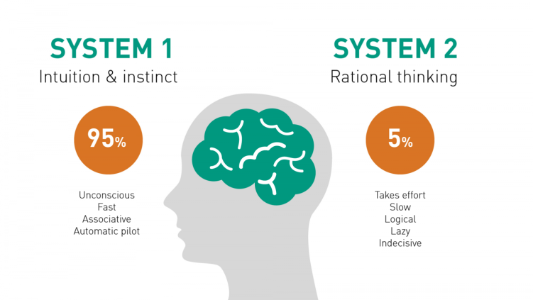

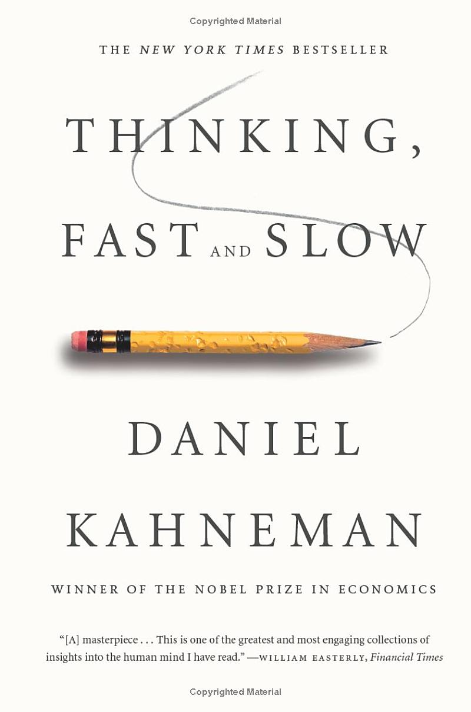
Real-life scenarios need both System 1 and System 2
Generate an image that shows a real-world scenario where both system 1 and system 2 thinking is required.
GPT4o (22 Apr 2025)
Overtime System2 tasks can become System1
Notes:
System 1 and System 2
The psychologist Daniel Kahenman popularized two kinds of thinking: System 1 and System 2. Yan LeCun and others have been very clear. If deep neural networks are doing anything like reasoning at all, it’s strictly System 1. That’s not an intuitive judgement, either, the research bears this out. Deep neural networks are not doing symbolic reasoning (a little louder for the breathless folks in the back).
System 1: Fast, Automatic Reasoning
Automatic: Processes information automatically without conscious control.
Fast: Decisions and assessments are made quickly.
Heuristic-based: Often relies on rules of thumb, mental shortcuts, or stereotypes.
Emotion-driven: Emotions and gut feelings can heavily influence decisions.
Effortless: Requires little or no cognitive effort.
Examples: Recognizing faces, reading emotions, basic arithmetic like 2+2, and simple motor skills are often driven by System 1.
System 2: Slow, Deliberative Reasoning
Conscious: Requires active, deliberate cognitive effort.
Slow: Takes time to process information and make decisions.
Logical: Tends to rely on formal methods of reasoning, following rules or structured approaches.
Resource-Intensive: Consumes more cognitive resources and energy.
Controlled: Can follow rules, compare options, weigh pros and cons, and reason logically.
Examples: Solving complex math problems, making high-stakes decisions, and evaluating complicated situations typically involve System 2 reasoning.
Somehow, humans do both. Though, if you watch the same YouTube channels my kids do, you might wonder if humans do any System 2 at all. But let’s be generous.
System 1 + 2
Statistical models of intelligence like deep neural networks roughly equate to System 1 thinking. Symbolic models of intelligence roughly equate to System 2 thinking. The field of neurosymbolic AI is looking for ways to create intelligent systems with System 1 and System 2 capabilities. Call it the holy grail of machine intelligence, just one more next step in machine intelligence, call it J.A.R.V.I.S. Whatever it is, the promise is huge. Uniting the strengths of statistical and symbolic AI in a fully integrated way really could give us systems that learn on their own, truly reason, solve a wider range of problems, and do so in a way that is more interpretable and explainable to us. Or so the theory goes.
It's a great theory. Many of the biggest names in AI research seem to think so. And the more I read the more interested I get. The possibilities are exciting. But even more, it’s an intellectually exciting goal.

Slide 23

Large Reasoning Models (LRMs)
I have 2 bananas in the room, 1 fell down. How many bananas are left in the room?
----------------------
So I have this problem: "I have 2 bananas in the room, 1 fell down. How many bananas are left in the room?" Hmm, it seems straightforward, but I want to make sure I understand it correctly.
First, there are 2 bananas in the room. That's clear. Then, it says 1 fell down. Now, did it fall out of the room or is it still in the room but maybe on the floor?
Wait, the question is "how many bananas are left in the room?" So, if one fell down, but it's still in the room, just perhaps not on the table or wherever they were originally, then there should still be 2 bananas in the room.
But maybe "fell down" implies that it left the room. Let me think about that.
The problem doesn't specify where the banana fell. It just says "fell down." So, if it's in the room and it fell down, it's probably still in the room, just maybe on the floor.
Alternatively, if the room has only one exit and the banana fell towards that exit and rolled out, then it might be out of the room.
But, without more information, I think the safest assumption is that both bananas are still in the room, even if one of them is on the floor.
So, the answer should be 2 bananas are left in the room.
Wait a minute, another thought. Maybe "fell down" means it was dropped and stayed where it was, so still in the room.
Alternatively, perhaps "fell down" means it was thrown or dropped and left the room.
But again, without specific information, I think assuming it's still in the room is reasonable.
Alternatively, perhaps the problem is testing basic subtraction, and "fell down" means it's no longer present in the room, so you subtract one from two, getting one.
But that seems a bit simplistic for a problem like this.
Alternatively, maybe there's a trick here. Maybe "fell down" doesn't mean it left the room, so the number remains two.
Hmm.
Alternatively, perhaps the problem is considering only bananas that are intact or in their original position, and the one that fell down is no longer considered "in the room" in the same way.
But that seems like splitting hairs.
I think the most straightforward interpretation is that both bananas are still in the room, just one is on the floor.
Therefore, the answer is 2 bananas are left in the room.
Alternatively, if "fell down" means it left the room, then it would be 1 banana left in the room.
But based on the information given, I think 2 is the better answer.
Final Answer
2

Slide 24
 | Large Language Models LLMs | Large Reasoning Models LRMs
Scaling Paradigm | Next-Token, Simple CoTs | Complex CoTs, Search
Reasoning Type | System 1 | System 2
Interaction | Tokens are helpful | So called Thinking tokens can be overwhelming or even hidden in some cases.
Famous Models | GPT4o, Llama, DeepSeek-V3, Mistral | OpenAI o1/o3, DeepSeek-R1, Sky-T1, QwQ

Slide 25
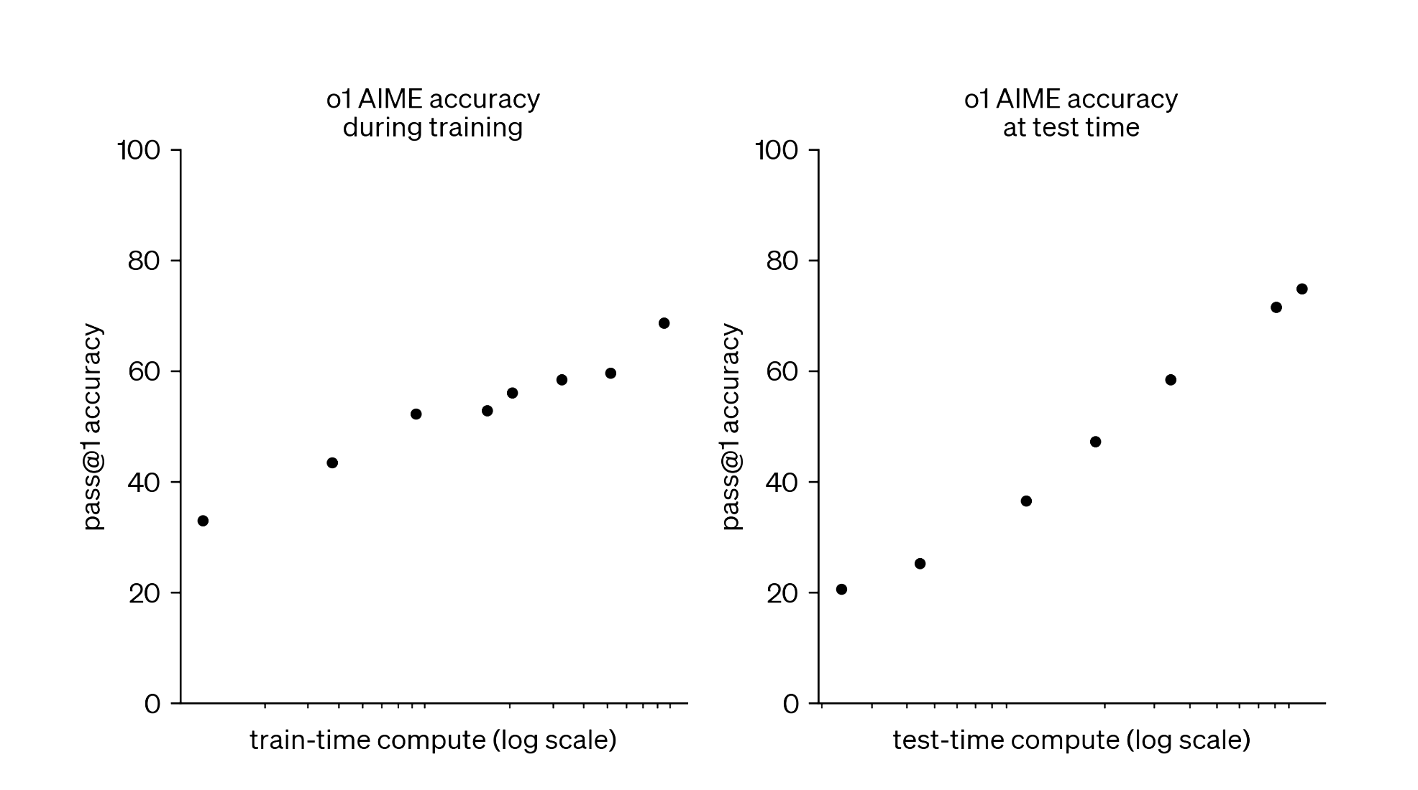
Training vs. Inference Time Scaling
Better Data
Difficulty
Quality
SDG
Architecture
Filtering
ORMs
Alignment
Search algorithms
Long CoTs
Agentic Behavior
Tools
PRMs
Self-Correction
Reflection
OpenAI 2024 Blog

Slide 26
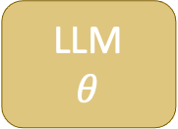
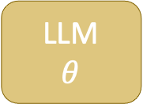

Test-Time Scaling Approaches
Generate multiple answers
Selector
Majority based
(Self consistency)
Incremental
(MCTS, Beam Search)
LLM
$$θ$$
Prompt
Solution
No Guarantees
If we have access to a lot of compute and time at inference time
Verifier
Formal
Learned
Synthesized
LLM
$$θ$$
Prompt
Solution
Generate a candidate solution
Full/Partial
Guarantees
Feedback
LLM
$$θ$$
Prompt
Solution
LongCoT
Full/Partial
Guarantees

Slide 27
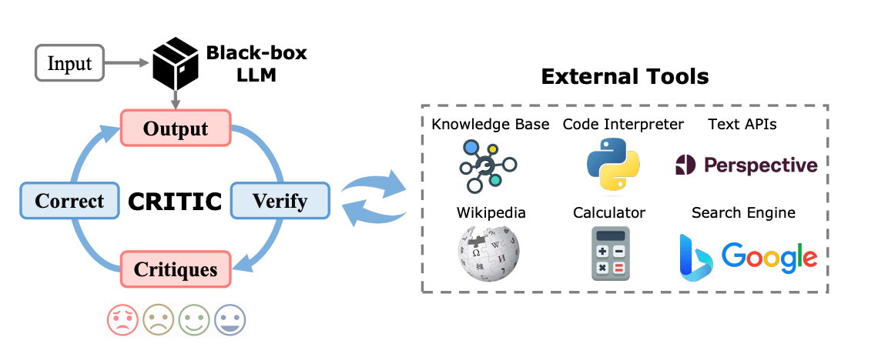
Agents
LLMs that can critique their own decisions and improve output
SWE agents have shown an incredible progress
Intermediate steps can be kept hidden from the user or shared for full explainability
A good agent excels in:
Reasoning/Planning
Tool use
https://one-piece.medium.com/llm-agents-revolution-unleashing-unprecedented-performance-with-the-agent-reflection-workflow-eb057305008a

Slide 28
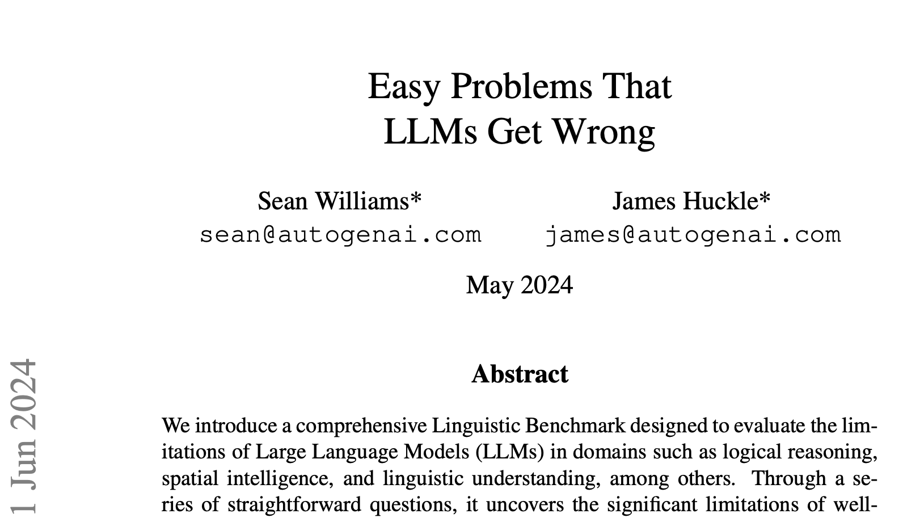
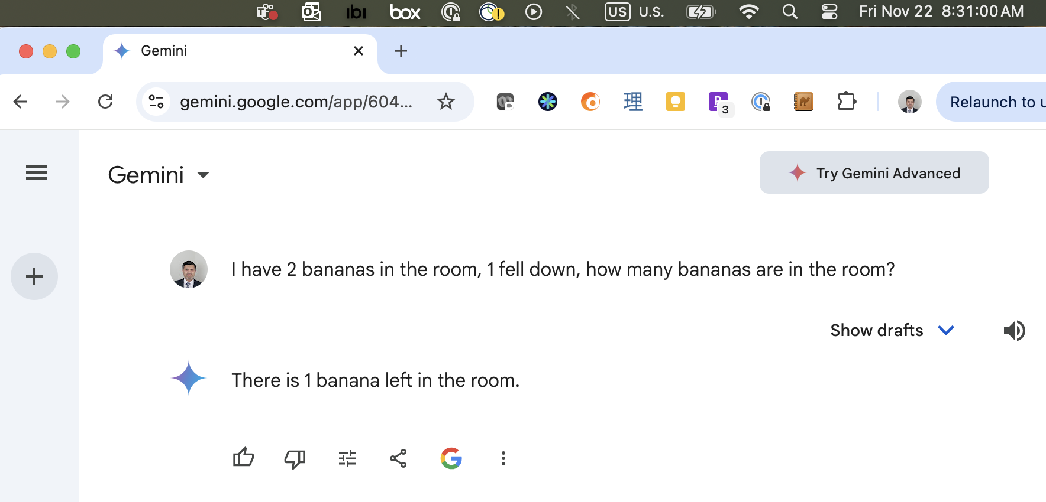
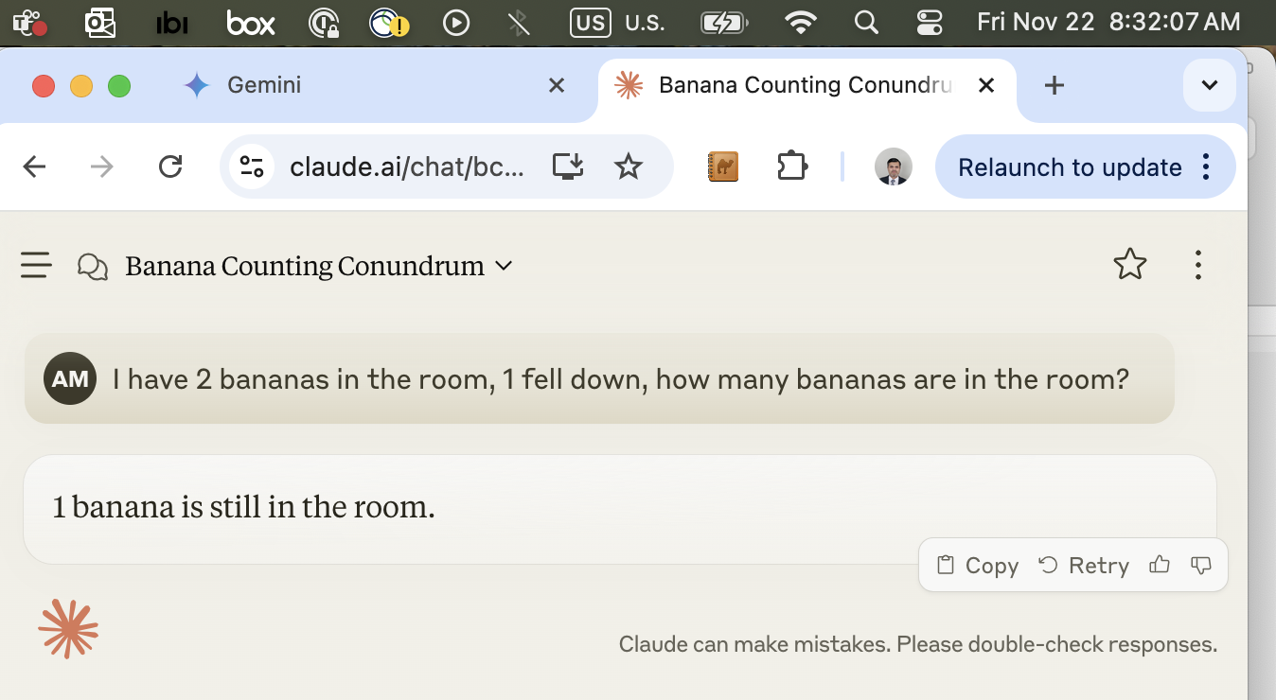
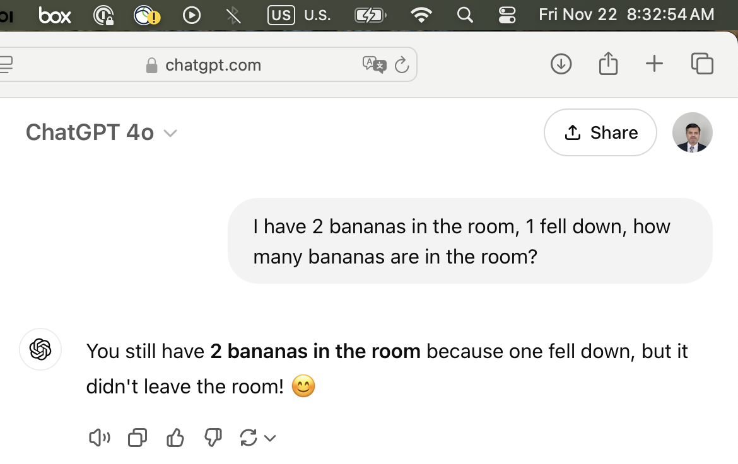
How to Train an LRM?

Slide 29


-o1 | -R1 and Beyond
OpenAI-o1 was the first successful LRM
Why DeepSeek-R1 got so much attention?
Full pipeline for building LRMs
Open sourced the models
Algorithmic advances

Slide 30
DeepSeek-V3
Qwen 1.5, 7, 14, 32b
Llama 8, 70b
1000s of CoT examples with Human in the Loop Curation
Fine-tune
Good model to start RL
Reasoning: ~144k CoT GSM8K, MATH, etc
GRPO with 2 rule-based rewards
Fine-tune with Distillation
Filter
Stronger reasoning, weaker general capabilities
Distilled R1 Models
~200k non-reasoning examples (writing, QA)
Fine-tune
~600k quality reasoning traces
Stronger reasoning, restored general capabilities
Reasoning + General: Mix of data types
GRPO with rule-based and RM for non-reasoning
DeepSeek-R1
Reasoning while prioritizing helpfulness and harmlessness

Slide 31
DeepSeek-V3
Qwen 1.5, 7, 14, 32b
Llama 8, 70b
1000s of CoT examples with Human in the Loop Curation
Fine-tune
Good model to start RL
Reasoning: ~144k CoT GSM8K, MATH, etc
GRPO with 2 rule-based rewards
Fine-tune with Distillation
Filter
Stronger reasoning, weaker general capabilities
Distilled R1 Models
~200k non-reasoning examples (writing, QA)
Fine-tune
~600k quality reasoning traces
Stronger reasoning, restored general capabilities
Reasoning + General: Mix of data types
GRPO with rule-based and RM for non-reasoning
DeepSeek-R1
Reasoning while prioritizing helpfulness and harmlessness
Diverse data sources
Synthetic data generation
Trained Verifiers
Reinforcement Learning

Slide 32
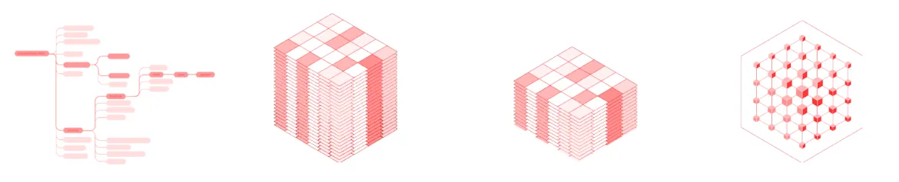
Synthetic Data Generation
Define the Domain
Data Generation with Teacher Model
Filter data with Validators
Train LLM with Distilled Data
Algorithmic Tasks
Rule-based tasks with clear steps and predictable outcomes.
May need external tools for complex computations.
Examples:
Math problems
Coding
Non-Algorithmic Tasks
Context-driven tasks with ambiguous or creative elements.
Often need world model.
Examples:
Summarization
Reading comprehension

Slide 33
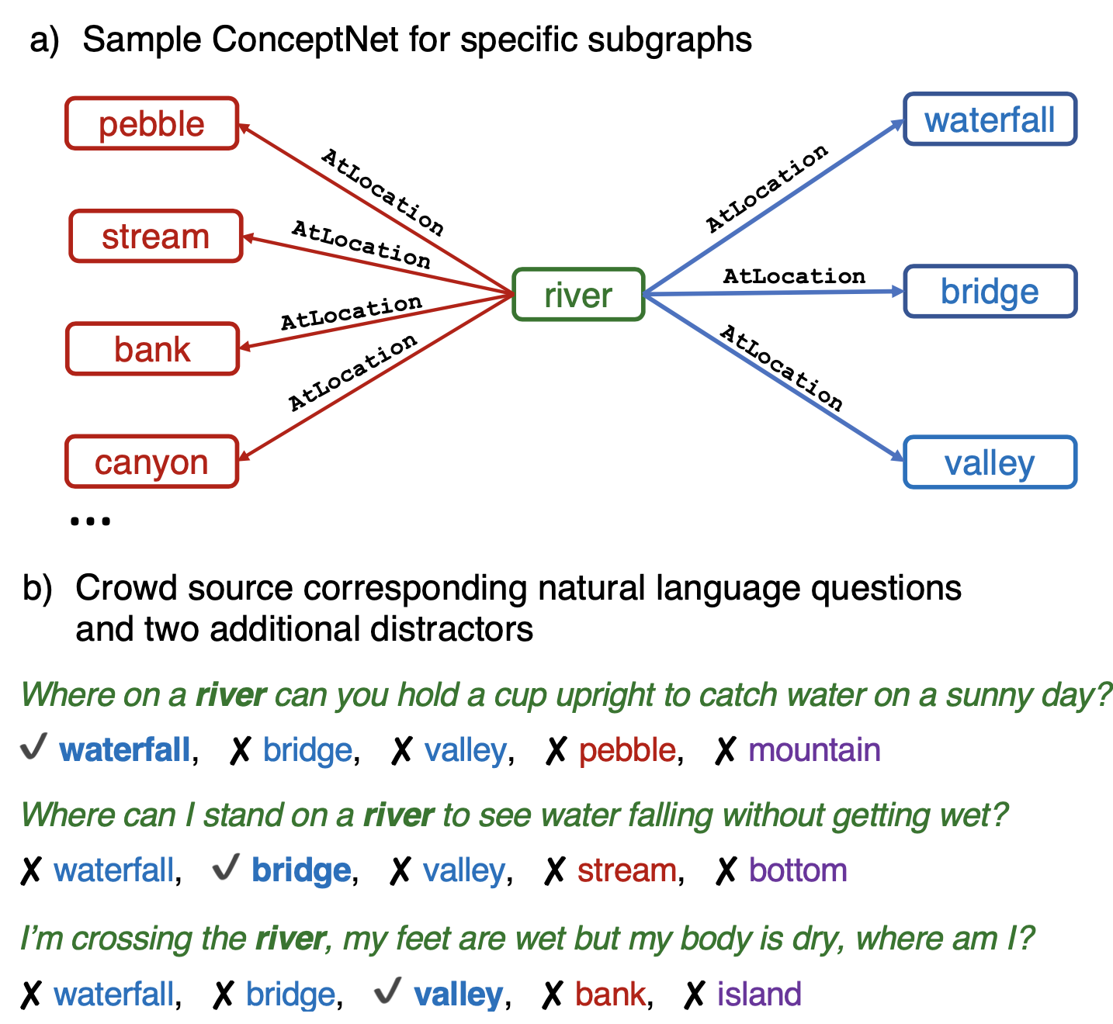
Knowledge Graphs (KGs) based SDG
Pre-training have a lot of unstructured text
KGs on the other hand are much higher quality, and vast amount of information is encoded as graphs
KGs (e.g. common-sense KG like ConceptNet) cannot be used directly in pre-training
KGs can be noisy
Templated data can be toxic for LLMs
Alon Talmor et al., COMMONSENSEQA: A Question Answering Challenge Targeting Commonsense Knowledge (2019), arxiv: 1811.00937v2
Notes:
This encourages workers to create ques- tions with complex semantics that often re- quire prior knowledge.

Slide 34
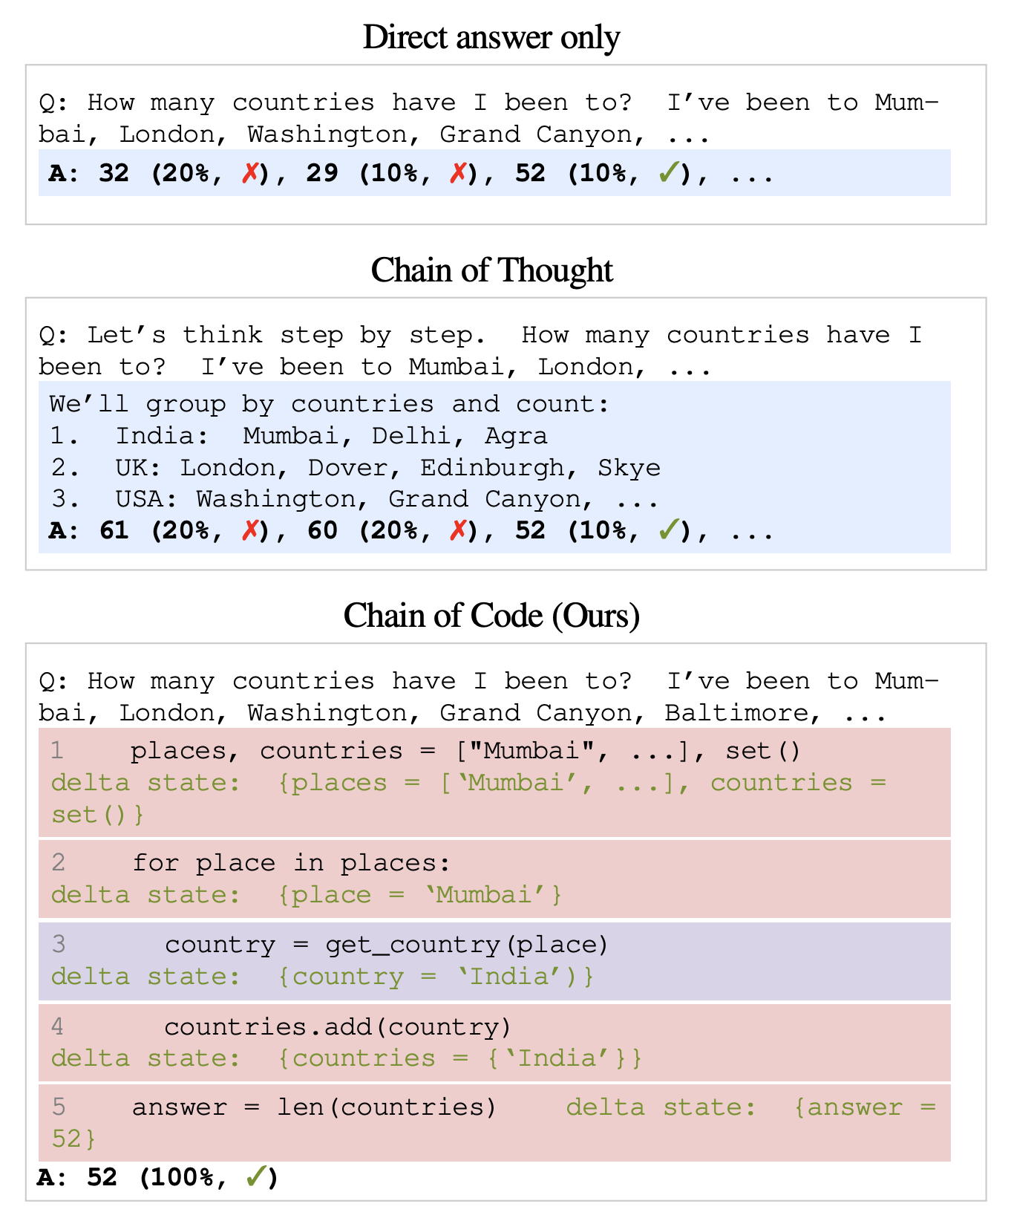
Code Assisted Data Generation
Chain of Code
We know that LLMs can be prompted to generate CoT reasoning as Text
LLMs are very good at generating code too
Works like Chain of Code can use reasoning and code for self-consistency
Li, C., Liang, J., Zeng, A., Chen, X., Hausman, K., Sadigh, D., Levine, S., Fei-Fei, L., Xia, F., & Ichter, B. (2024). Chain of Code: Reasoning with a language model-augmented code emulator. arXiv preprint arXiv:2312.04474.

Slide 35
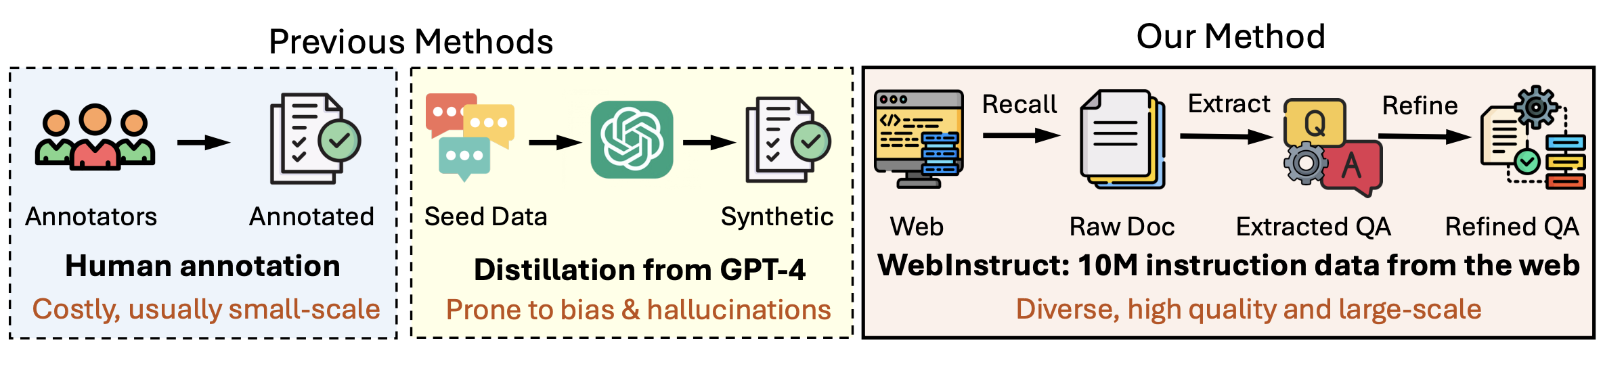
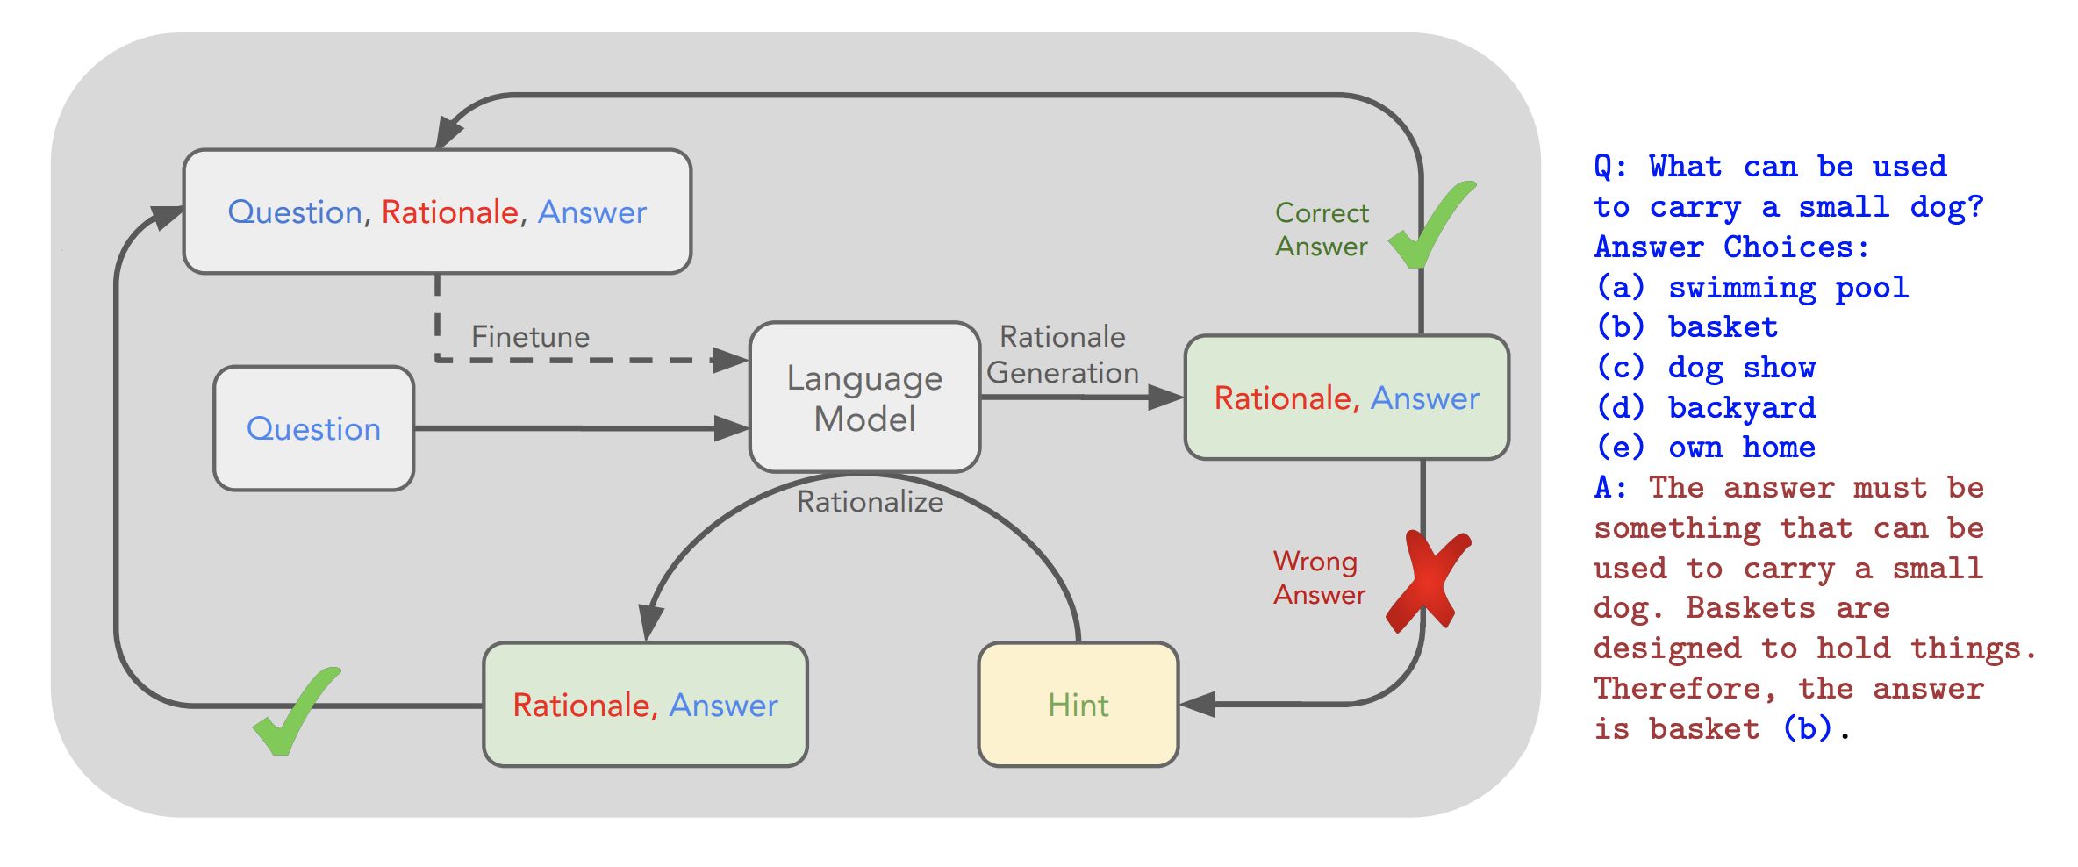
Pick topics from web crawls
MAmmoTH2: Scaling Instructions from the Web, Xiang Yue et al.
Diverse High Quality Synthetic Data
Create Intermediate reasoning from Answers
STaR: Self-Taught Reasoner Bootstrapping Reasoning With Reasoning Eric Zelikman

Slide 36
Data Filtering
Data (gold, crawled, synthetic) has been growing exponentially
So is the need for filtering
Metrices based – e.g. Perplexity etc.
LLM as a judge – Prompting the model
Reward models (ORMs, PRMs)
Human Eval
Self consistency
Search
Semantic Deduplication
PII removal

Slide 37
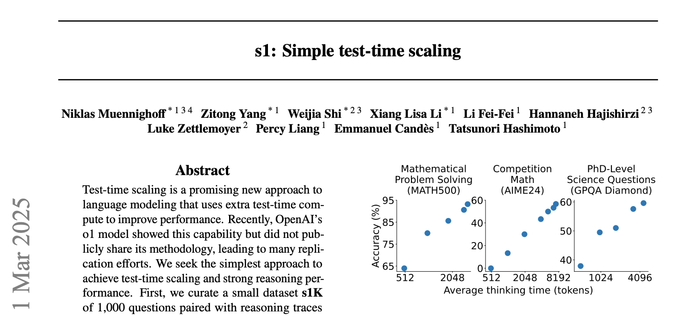
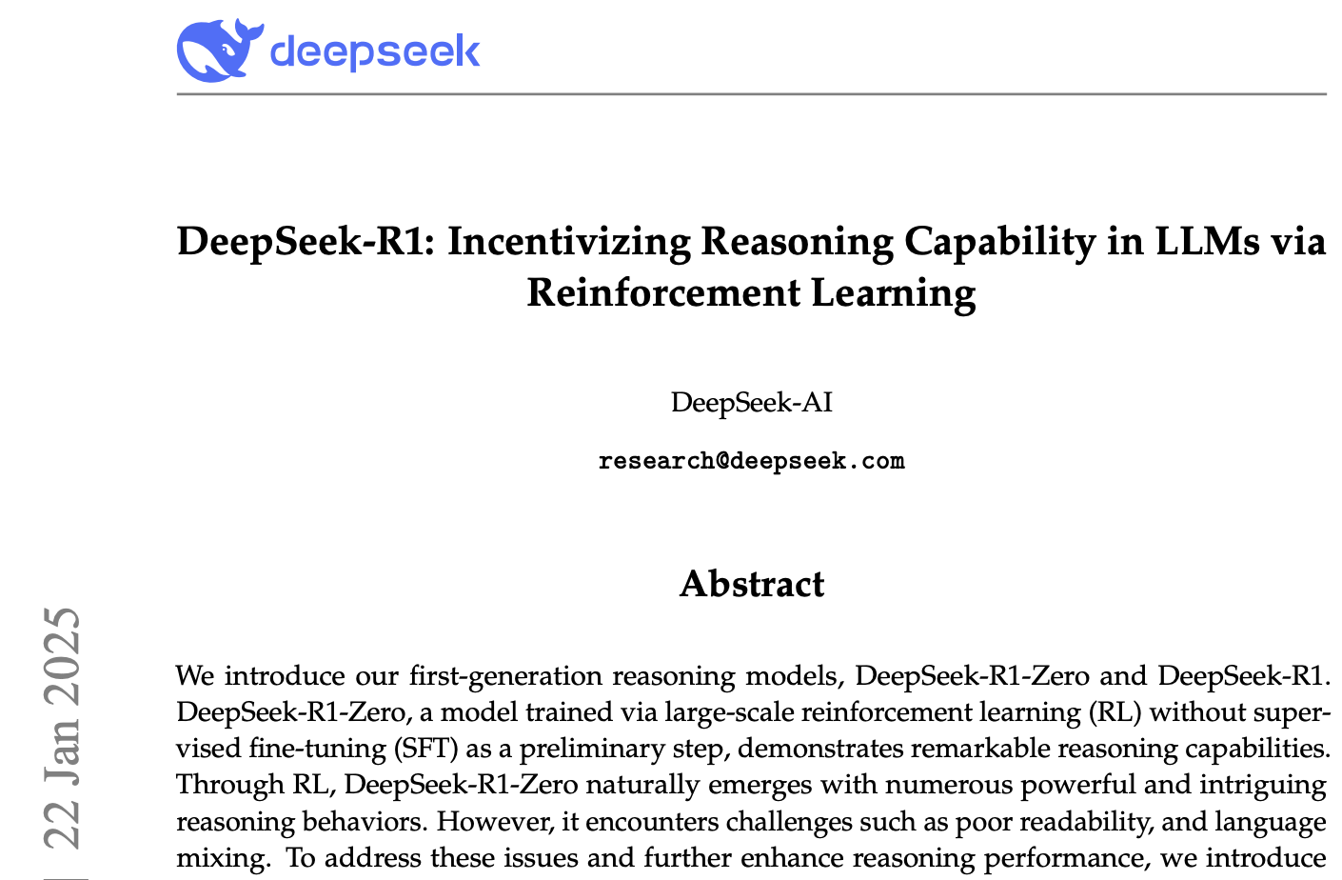
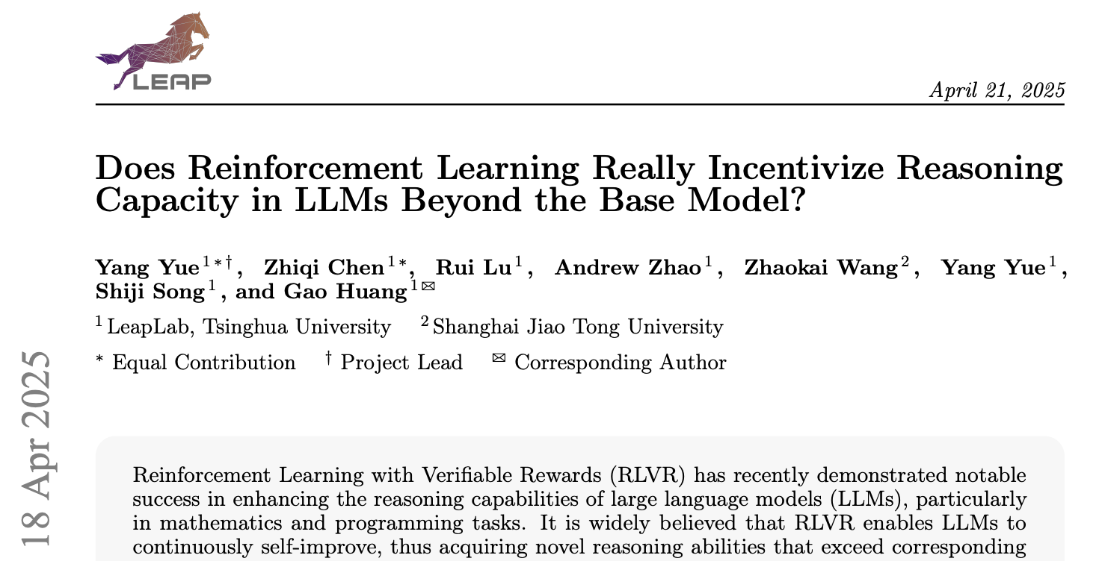
Good Reads

Slide 38


IBM Granite Models
IBM and Meta co-launched the AI Alliance
Focused on fostering an open community and enabling developers and researchers to accelerate responsible innovation in AI while ensuring scientific rigor, trust, safety, security, diversity and economic competitiveness.
https://www.ibm.com/granite

Slide 39
Conclusions
LLMs now exhibit emergent reasoning abilities, beyond simple pattern matching.
Yet, fundamental limitations—in consistency, grounding, and generalization—remain.
We must reframe LLMs: no longer just next-token predictors, but systems with latent reasoning potential.
Ongoing Research
High quality synthetic data
Agentic behavior with external tools
Inference time compute
RL methods
Benchmarks focused on real world problems
Future Focus
Neuro-Symbolic AI
Architectural changes
Knowledge and World models
True explainability

Slide 40




Thank you
connect with me
youtube.com/@asimmunawar
x.com/asimunawar
linkedin.com/in/asimmunawar
Asim Munawar

